Slide 1
DISPLAY BAR
https://www.figma.com/file/QK7ieK3cqB2MWZVSYjg0d3/Untitled?node-id=31-884&t=gtTHXIvcUKVU77l5-0

Slide 2
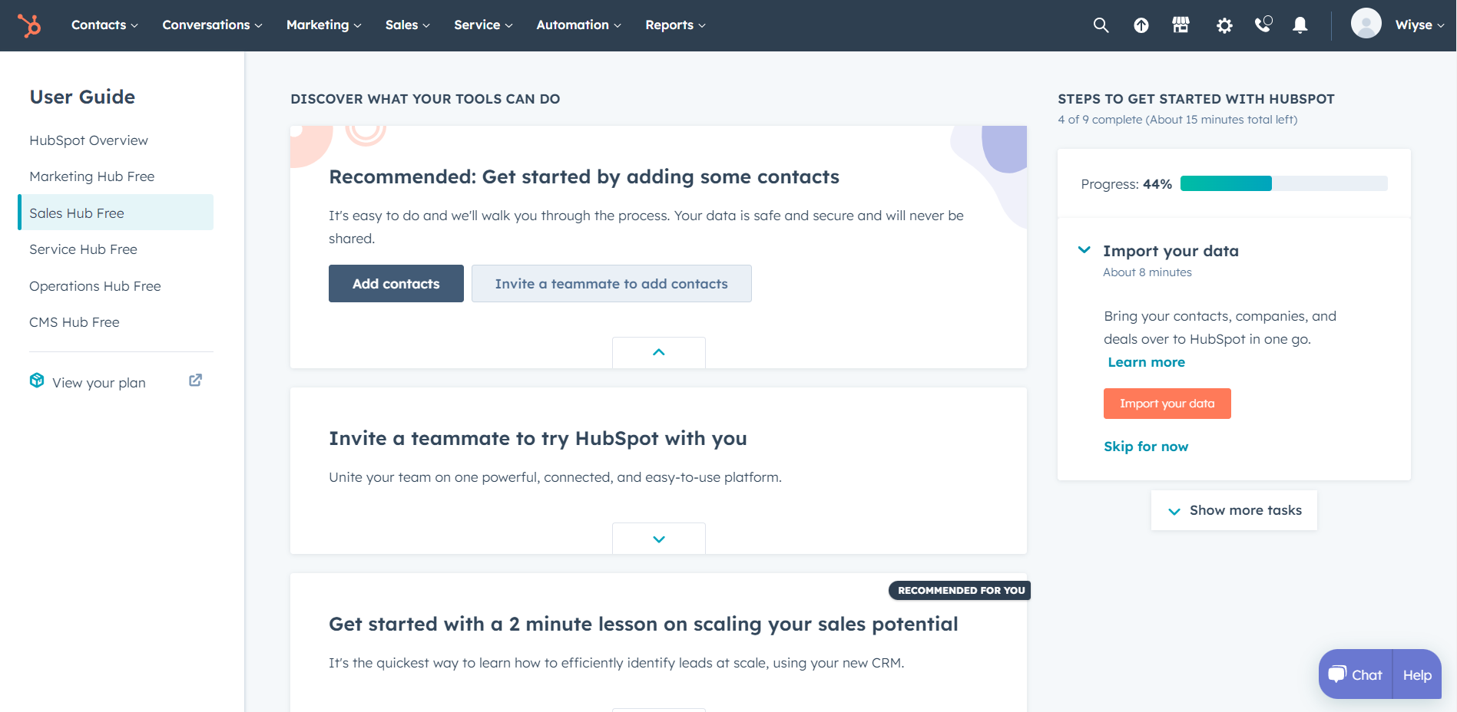
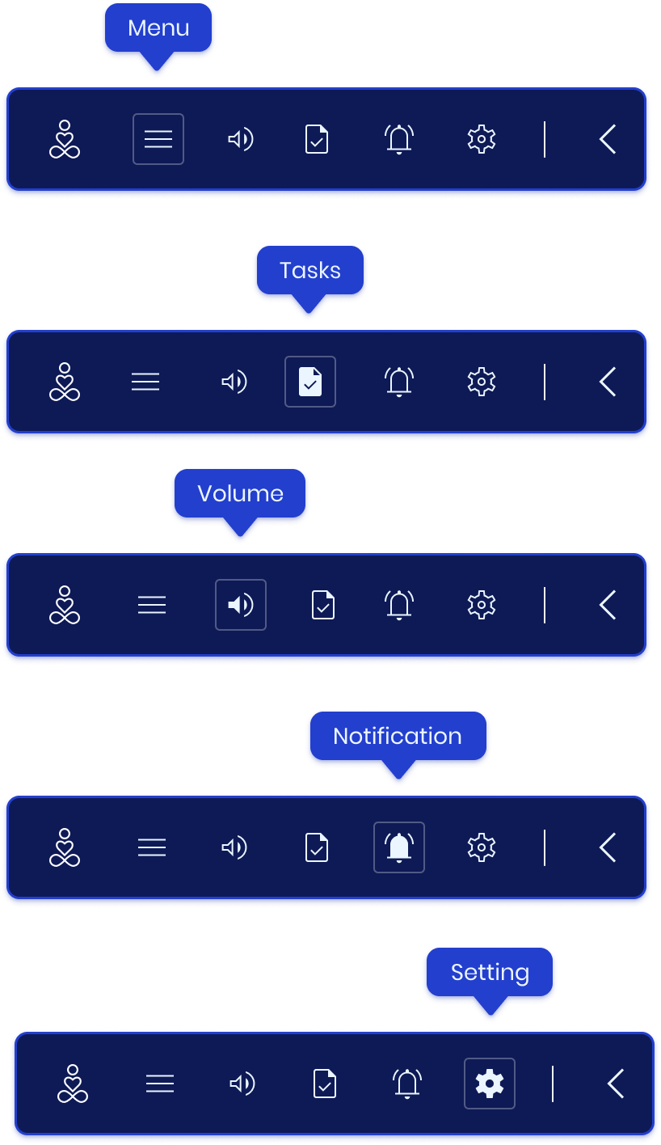



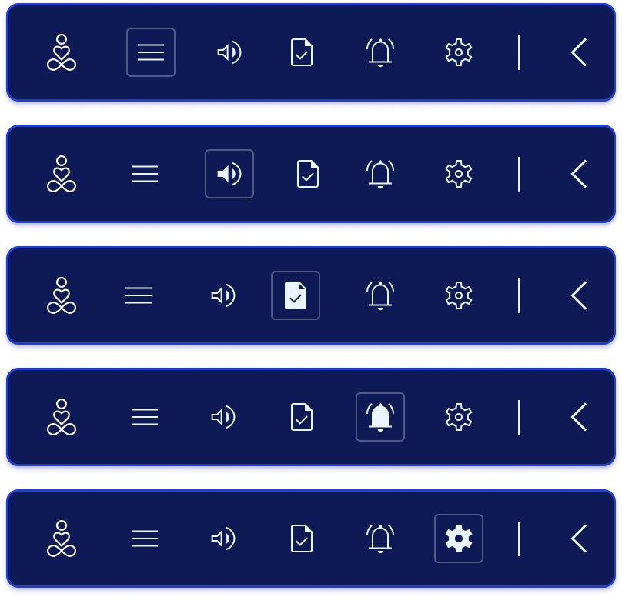
On Hover
Maximize bar
Minimize bar

Slide 3
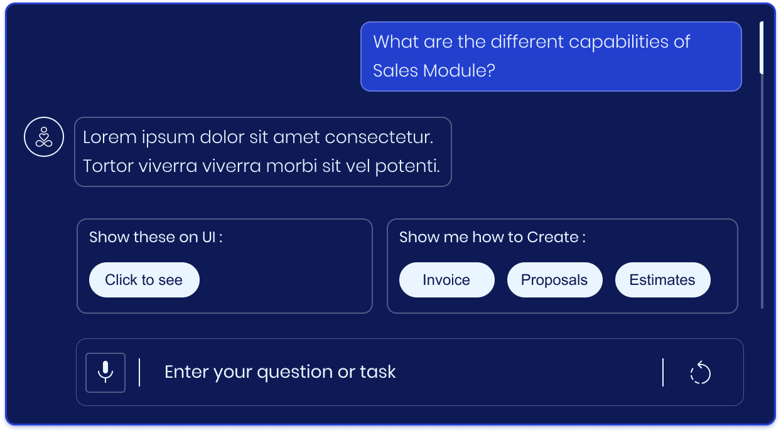

Expanded Chat window
Scroll
Buttons
Question Bar

Slide 4
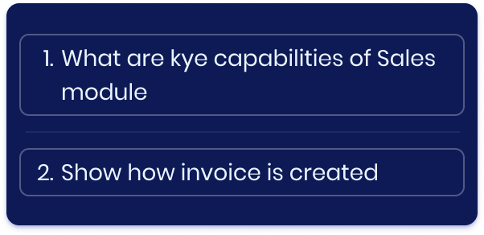

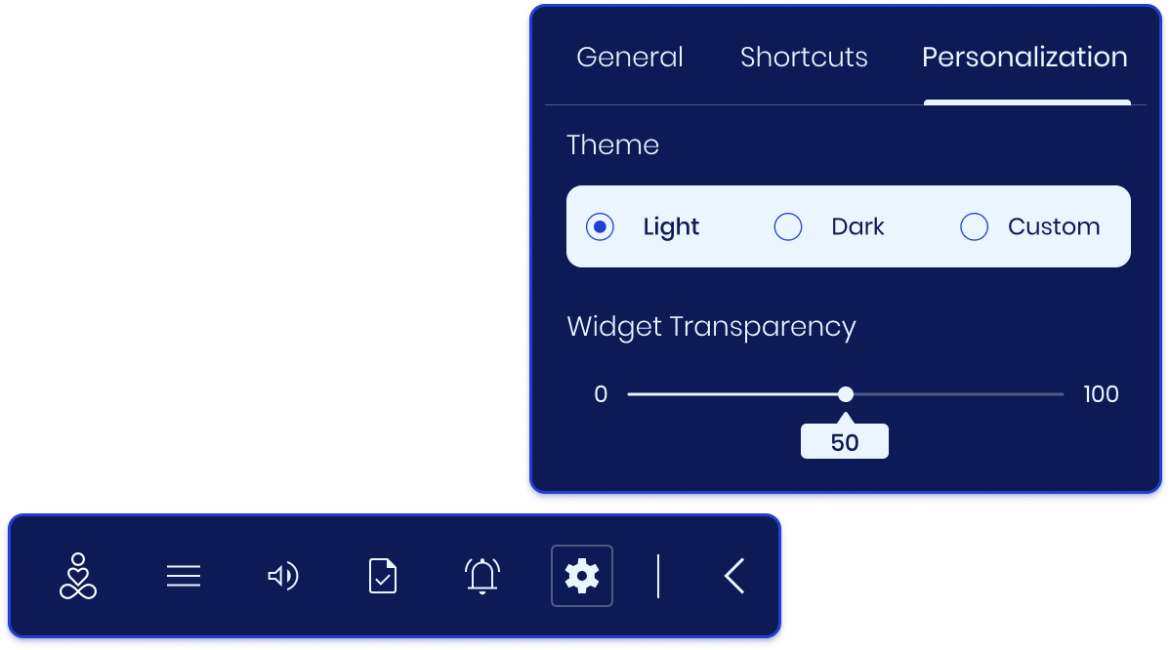
Question Bar

Slide 5
INTERACTION MENU
& DEMO MENU

Slide 6

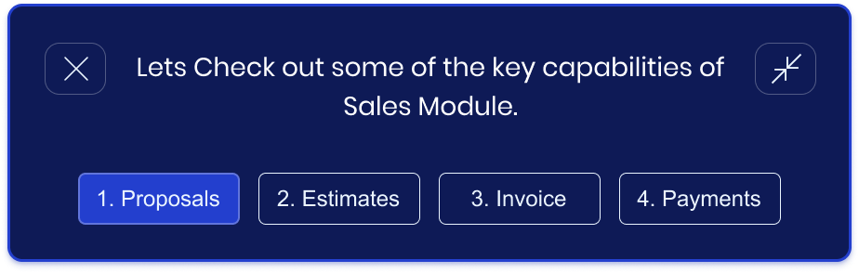

Slide 8
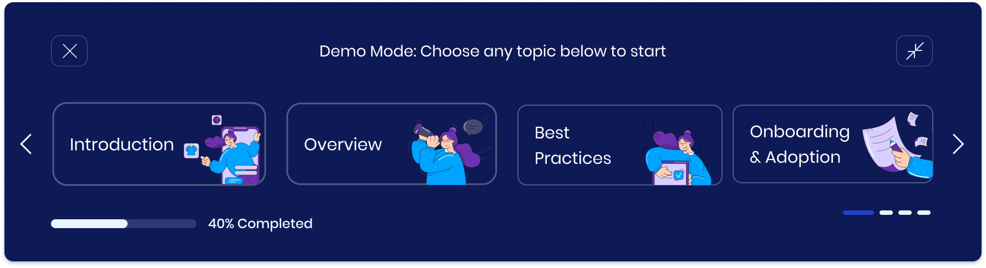

Slide 9

